Slide 1





Home
Assignment
Step 3
Presented by: Group B

Slide 2






Overview
Roadmap
ETL Workflow- Cont.
Target Variable consideration
Note potential issues
Potential Models

Slide 3







ROAD MAP
WEEK 0-2
WEEK 2-4
WEEK 4-6
WEEK 6-8
WEEK 8-10
WEEK 10-12
Business Understanding
Data Understanding/Data Preparation
Data Preparation/Modeling
Model selection and setup
Modeling/Evaluation
Evaluation/Deployment

Slide 4






Recap Data Available
Number of instances
Features
snap 2018
snap 2019
Number of instances
Features
-30.4%
expired_2019

Slide 5
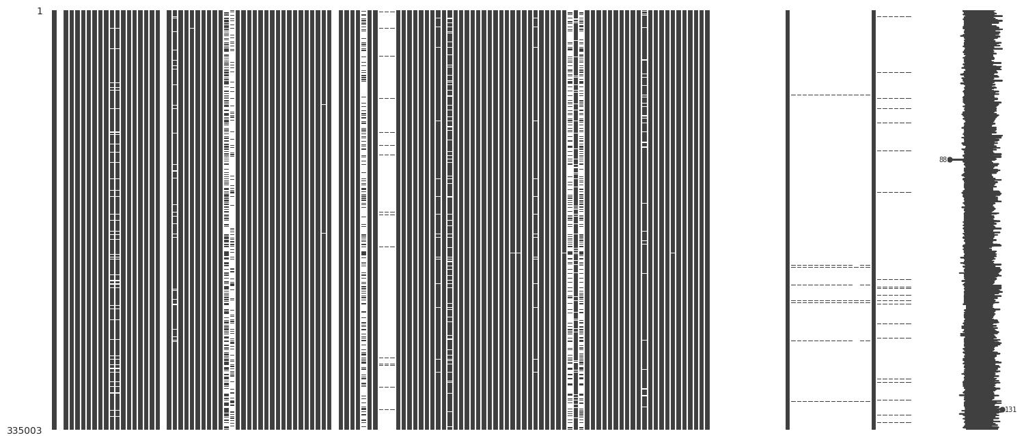
First Look At Our Data
expired_2019
Features 151
Instances 335,001

Slide 6
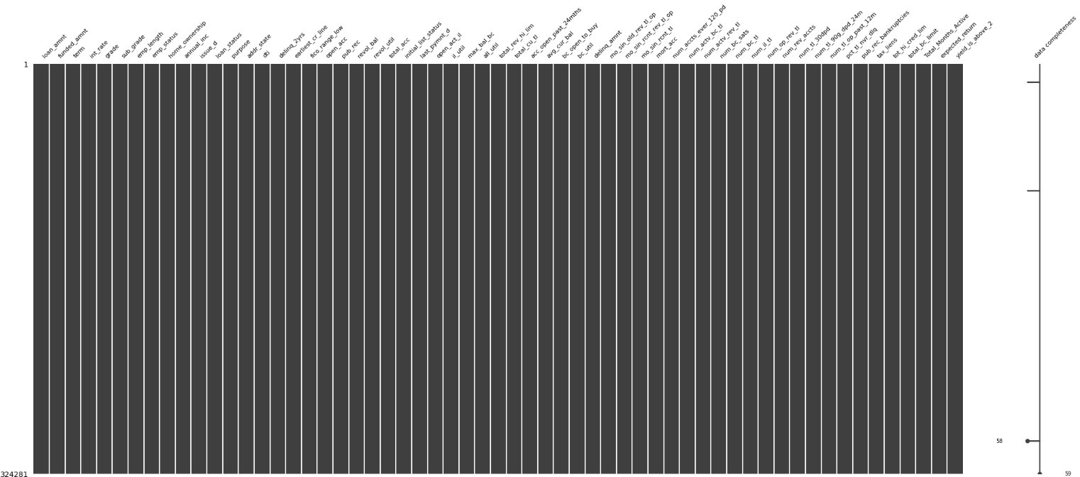
Data Frame After ETL
Features 62
Instances 319,733

Slide 7
ETL Workflow

Slide 8

Taylored Approach
Acknowledges distinct domain nuances, data types, and limitations
Rigorous and individualized feature handling
Captures vital nuances
Prevents information loss

Slide 9
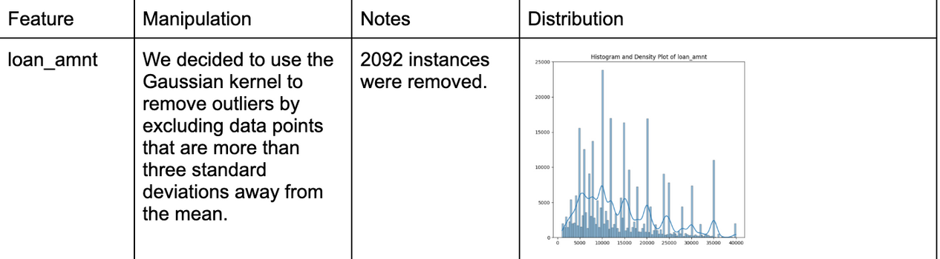
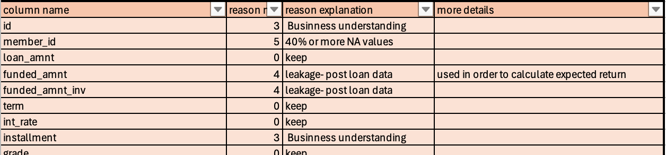
Practical Implentation
Manipulation Log
Excel File

Slide 10
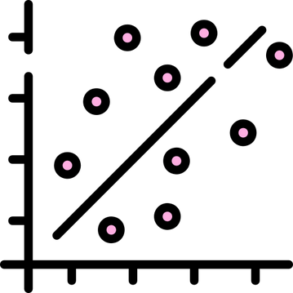
Last Chapter
Feature-Based Refining
Removed from 50% NA Treshhold (43)
No Variance features (5)
Leakage (14)
Business understanding (25)
High Correlation (7)
High Cardinality (4)
Relative Entropy (4)
Feature Encoding +14
Total features left 62

Slide 11

Instance-Based Refining
Duplicates. (0)
Missing Critical values (22550 instances)
High amount of NAs (60 instances)
Outliers (1,301)
Joint Applicants (5404)
Total instances left 319,733

Slide 12

Handeling NAs
Ttl Imputated Values (34,776)
Robust method
Completing missing values using statistical measures (mean, median and mode)
Derived from thorough analysis of feature distributions
Intend to test and compare with models using original incomplete data

Slide 13

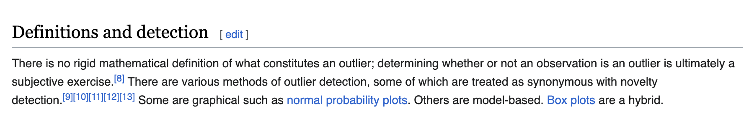
Handling Outliers
Wikipedia’s page on outliers

Slide 14

Guide lines
Instances that don’t represent the actual distribution
Low frequency
Outliers affecting only one variable might be easier to manage or justify removing, especially if they seem to stem from measurement errors, whereas multivariate outliers may indicate complex relationships or rare but important patterns.

Slide 15


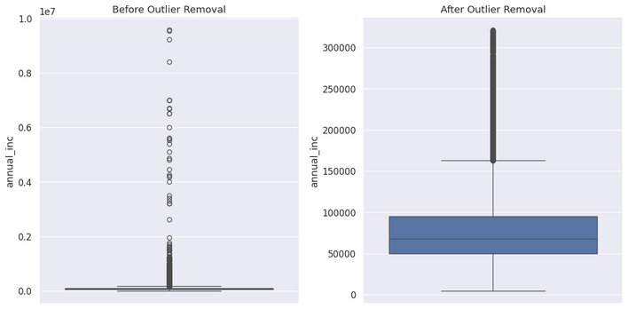
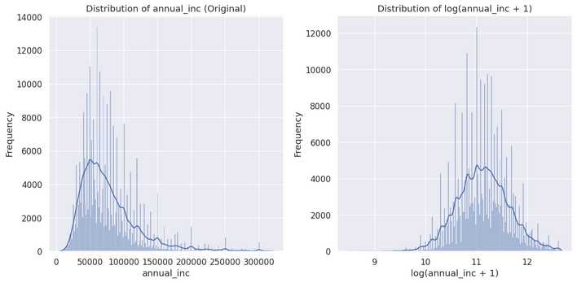
Detection and Removal (Tl removed 1,301)
Mean +-3*STD (GK)
Log Transformation
Manual analysis

Slide 16

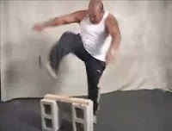
Potential Pitfalls
Missing Data Imputation
Rigid Thresholds
Information Loss in Feature Selection
Bias in Missing Data Handling
Outlier Treatment Concerns
Data Integrity Disregard: Over-manipulating data may compromise analysis reliability.

Slide 17
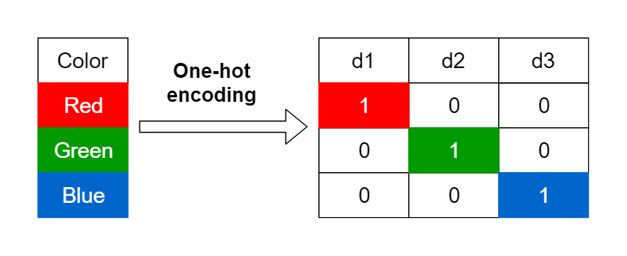
Handling Categorical Features
Ordinal Encoding

Slide 18

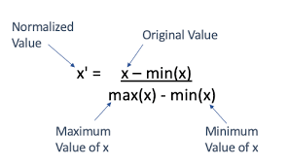
Normalization
Min-max normalization rescales data to a specified range, typically between 0 and 1

Slide 19
Potential Models
Regression
Classification
Continous Target
variable (expected return)
Discrete Target variable
Yeild above 2%
Linear Regression
Polynomial Regression
K-Nearest Neighbors
Decision Tree
Random Forest
Logistic Regression

Slide 20


BUILD& SET UP MODELS
COMING UP NEXT.....
FINE TUNING & TESTING
Step 4- Model Selection and Setup
EVALUATION

Slide 21


Thank you :)

